Slide 1
UW x PCTY Capstone Project
Final Presentation
Aarya Mehta
Claude Wang
Mahi Karnati
Steven Wang
Xingbang Liao
1

Slide 2
WHAT’S THE PROBLEM
2

Slide 3
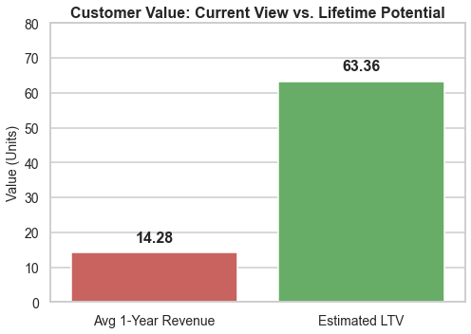
What's the Problem
How We Approached It
What We Discovered
How It Drives Strategy
The Blind Spot in SaaS Practices
Paylocity’s current view of customer value is backward-looking.
SaaS companies often know how much they made, not how much value clients still hold
Even when using LTV, most rely on averages — ARPU × retention
Paylocity makes most decisions based on average 1-year revenue
That downplays retention, growth, and time value of money
3

Slide 4



What's the Problem
How We Approached It
What We Discovered
How It Drives Strategy
Misallocation Without Forward Value
Same revenue, different lifetime value.
There’s no way to tell who’s high-value vs short-term
Resource allocation becomes guesswork
Retention, upsell, and acquisition aren’t targeted
The current model misses growth signals and customer heterogeneity
All revenue looks equal — until it doesn’t.
4

Slide 5
What's the Problem
How We Approached It
What We Discovered
How It Drives Strategy
Data Sources Behind the Model
What powers our analysis: 5 years of billing, behavior, and customer profile data
📊 1. Billing Data (NetSuite)
5 fiscal years of client-level billing
Reflects cash flow, not booked revenue
Note: Excludes child-parent mapping (reseller/partner level)
👥 2. Client Profiles (Salesforce)
Segment, Employee Count, Industry, Region
Used for segmentation and CAC estimation
🚥 3. Account Health (Salesforce)
5 years of status data (Green / Yellow / Red / Grey / Black)
Used to infer retention risk and model churn patterns
📁 4. CAC Estimates (Provided)
Segment-level CAC based on lead → close rates
Benchmark only — not actual spend
5

Slide 6
HOW WE APPROACHED IT
6

Slide 7
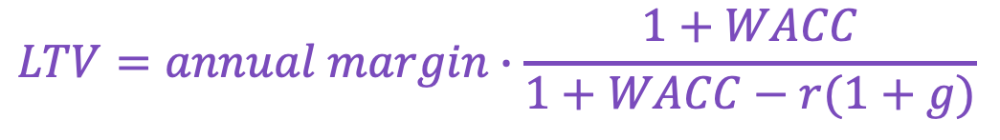
What's the Problem
What We Discovered
How We Approached It
How It Drives Strategy
A Behavior-Driven Pipeline
From revenue tracking → to value forecasting
Behavioral Signals
Predicted Lifespan
Retention Rate
Clustering
Growth Rate
$$LTV=annual margin∙\frac{1+WACC}{1+WACC−r(1+g)}$$
We modeled clients’ actual behavior
No more one-size-fits-all
7

Slide 8
What's the Problem
What We Discovered
How We Approached It
How It Drives Strategy
Modeling Retention — Predicting How Long Clients Stay
Retention is derived, not assumed
⚠️ The Problem We Faced
Multi Collinearity
Limited features
Low predictive value
No access to behavioral logs
Missing transactional signals
Lacked engagement metrics
8

Slide 9
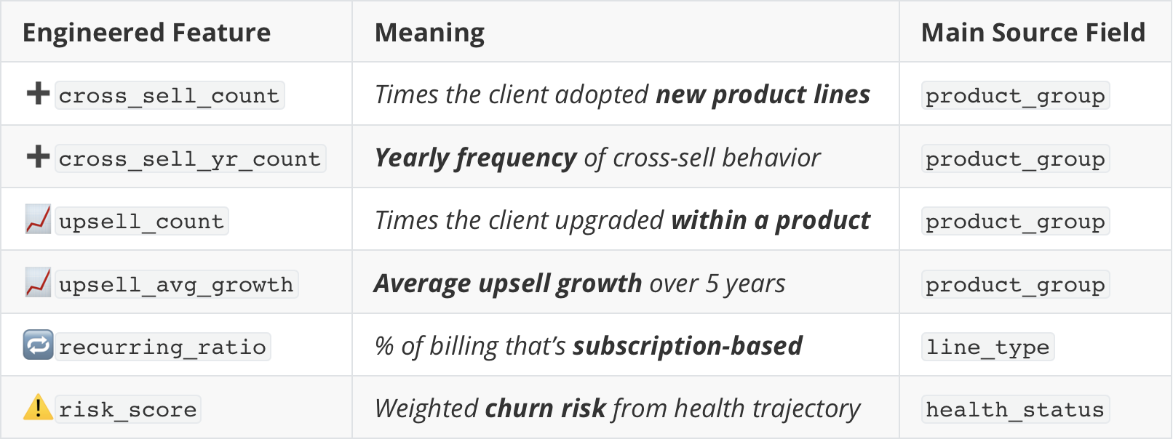
What's the Problem
What We Discovered
How We Approached It
How It Drives Strategy
Modeling Retention — Our Feature Engineering Solution
If we can't measure behavior directly, let's infer it from what we do have
💡 The Result
Transformed weak profile signals into strong predictive features
9

Slide 10
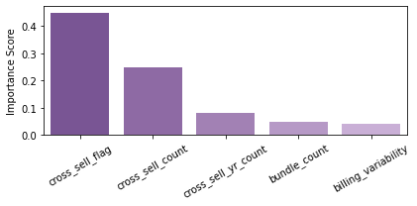
What's the Problem
What We Discovered
How We Approached It
How It Drives Strategy
Modeling Retention — Feature Importance (XGBoost) Top 5​
What features impacting the model performance?​
Predicting Power:
Profile
Industry
Headcount
Behavior
Health
Subscription
Cross-sell
<
💡 Cross-selling features altogether explain over 75% variance
10

Slide 11
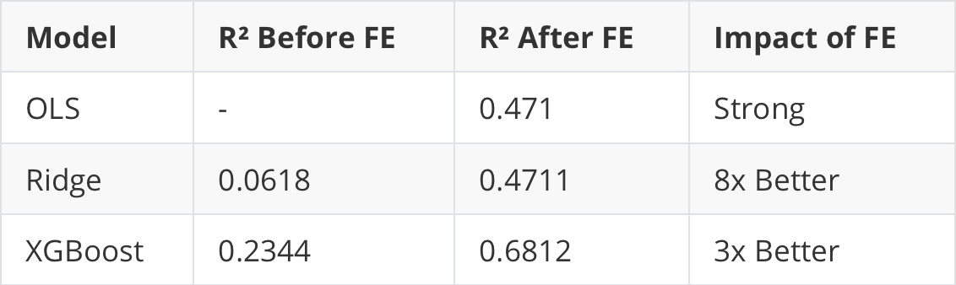
What's the Problem
What We Discovered
How We Approached It
How It Drives Strategy
Modeling Retention — Results & Performance
How Did Feature Engineering Boost Performance?
Feature Engineering
✅ Key success:
Feature engineering increased model performance 8x for Ridge and 3x for XGBoost, proving that creative data engineering can overcome behavioral data limitations and deliver actionable business intelligence.
11

Slide 12
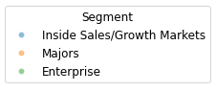
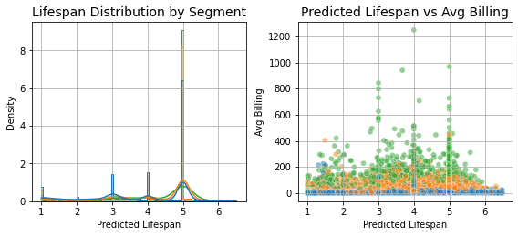
What's the Problem
What We Discovered
How We Approached It
How It Drives Strategy
Retention as a Value Signal
Predicted Lifespan Patterns and Their Billing Impact Across Segments
12

Slide 13
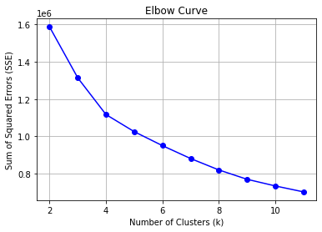
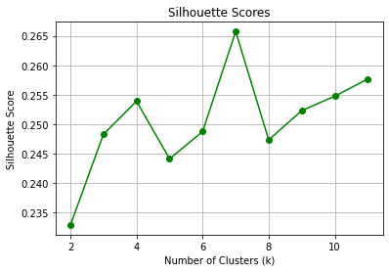
What's the Problem
What We Discovered
How We Approached It
How It Drives Strategy
Growth Assignment – Based on Cluster Behavior, Not Heuristic
Growth isn’t adjusted based on heuristic rules — it adapts to cluster performance
All clients start with baseline growth rate 4.4% (inflation)
We used KMeans++ to cluster clients (k = 7) based on behavioral and billing features
Clustering quality was validated using Elbow and Silhouette methods
7 clusters offered the best balance of compactness and separation.
13

Slide 14
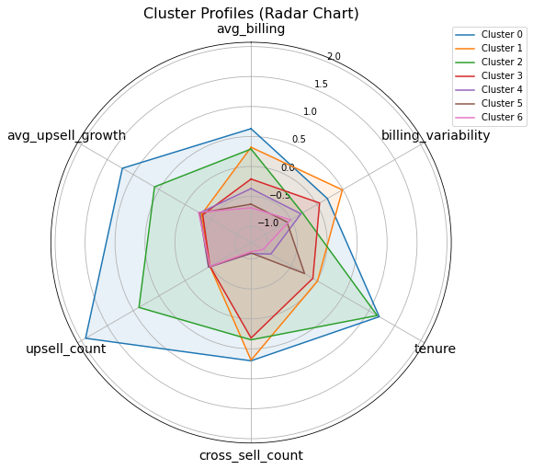
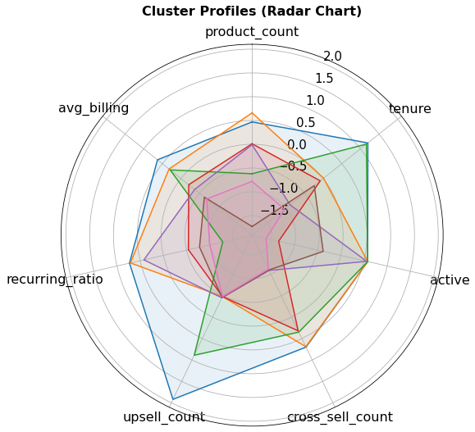
What's the Problem
What We Discovered
How We Approached It
How It Drives Strategy
Growth Assignment – Based on Cluster Behavior, Not Heuristic
Growth isn’t adjusted based on heuristic rules — it adapts to cluster performance
For select clusters, we adjust upward
Cluster 0: High Billing + High Engagement
Cluster 1: High Billing + Broad Usage
Cluster 4: New & Active
14

Slide 15
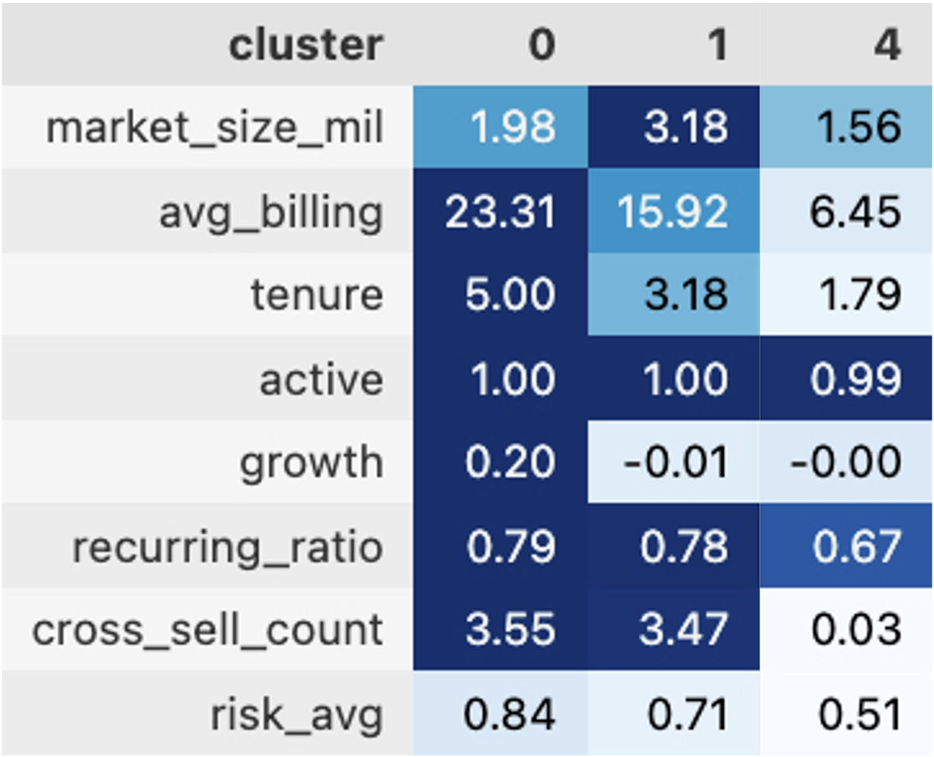
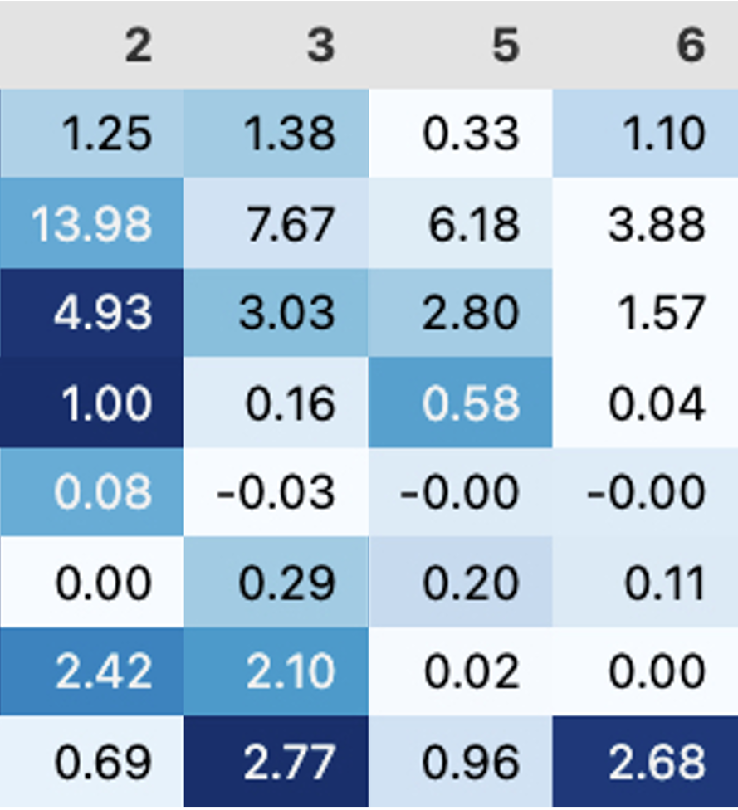
What's the Problem
What We Discovered
How We Approached It
How It Drives Strategy
Growth Assignment – Based on Cluster Behavior, Not Heuristic
Growth isn’t adjusted based on heuristic rules — it adapts to cluster performance
For select clusters, we adjust upward
Cluster 0: High Billing + High Engagement
Cluster 1: High Billing + Broad Usage
Cluster 4: New & Active
15

Slide 16
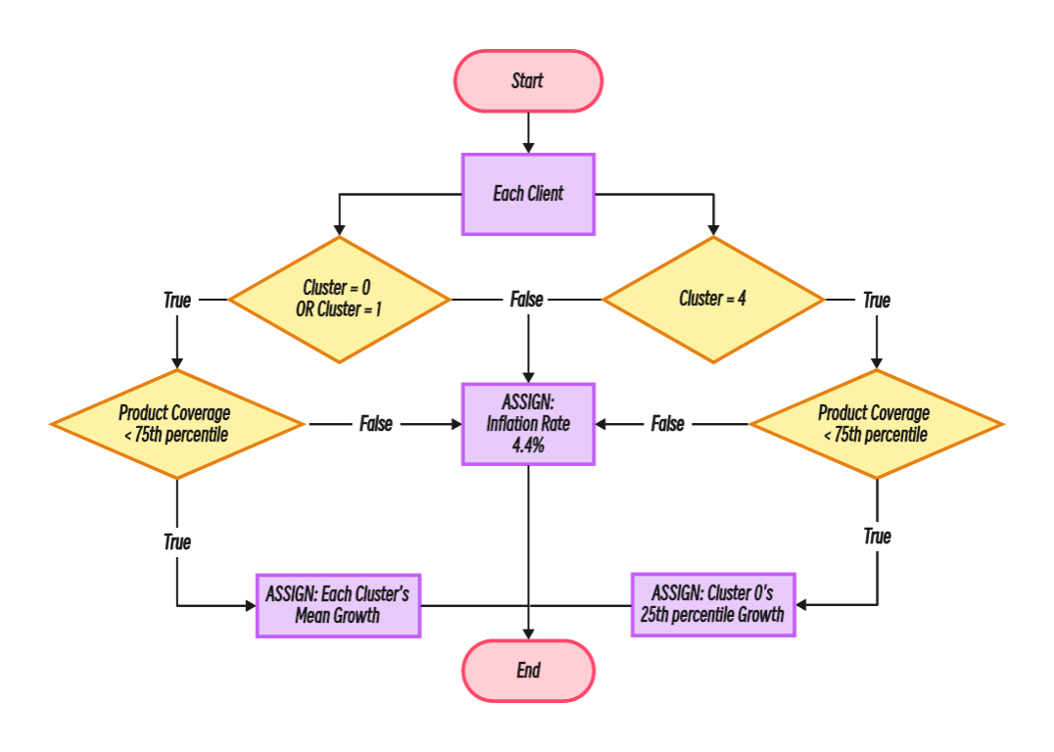
What's the Problem
What We Discovered
How We Approached It
How It Drives Strategy
Growth Assignment – Based on Cluster Behavior, Not Heuristic
Growth isn’t adjusted based on heuristic rules — it adapts to cluster performance
Adjust ↑ for clients with room to expand ▸ Defined as below the 75th percentile in product coverage
If in Cluster 0 or 1 ▸ Assigned the cluster’s historical mean growth
If in Cluster 4 (new, active) ▸ Mapped to the 25th percentile growth of Cluster 0 ▸ Why? We treat them as early-stage versions of Cluster 0 — with caution
All others default to 4.4% baseline (inflation rate)
16

Slide 17
WHAT WE DISCOVERED
17

Slide 18
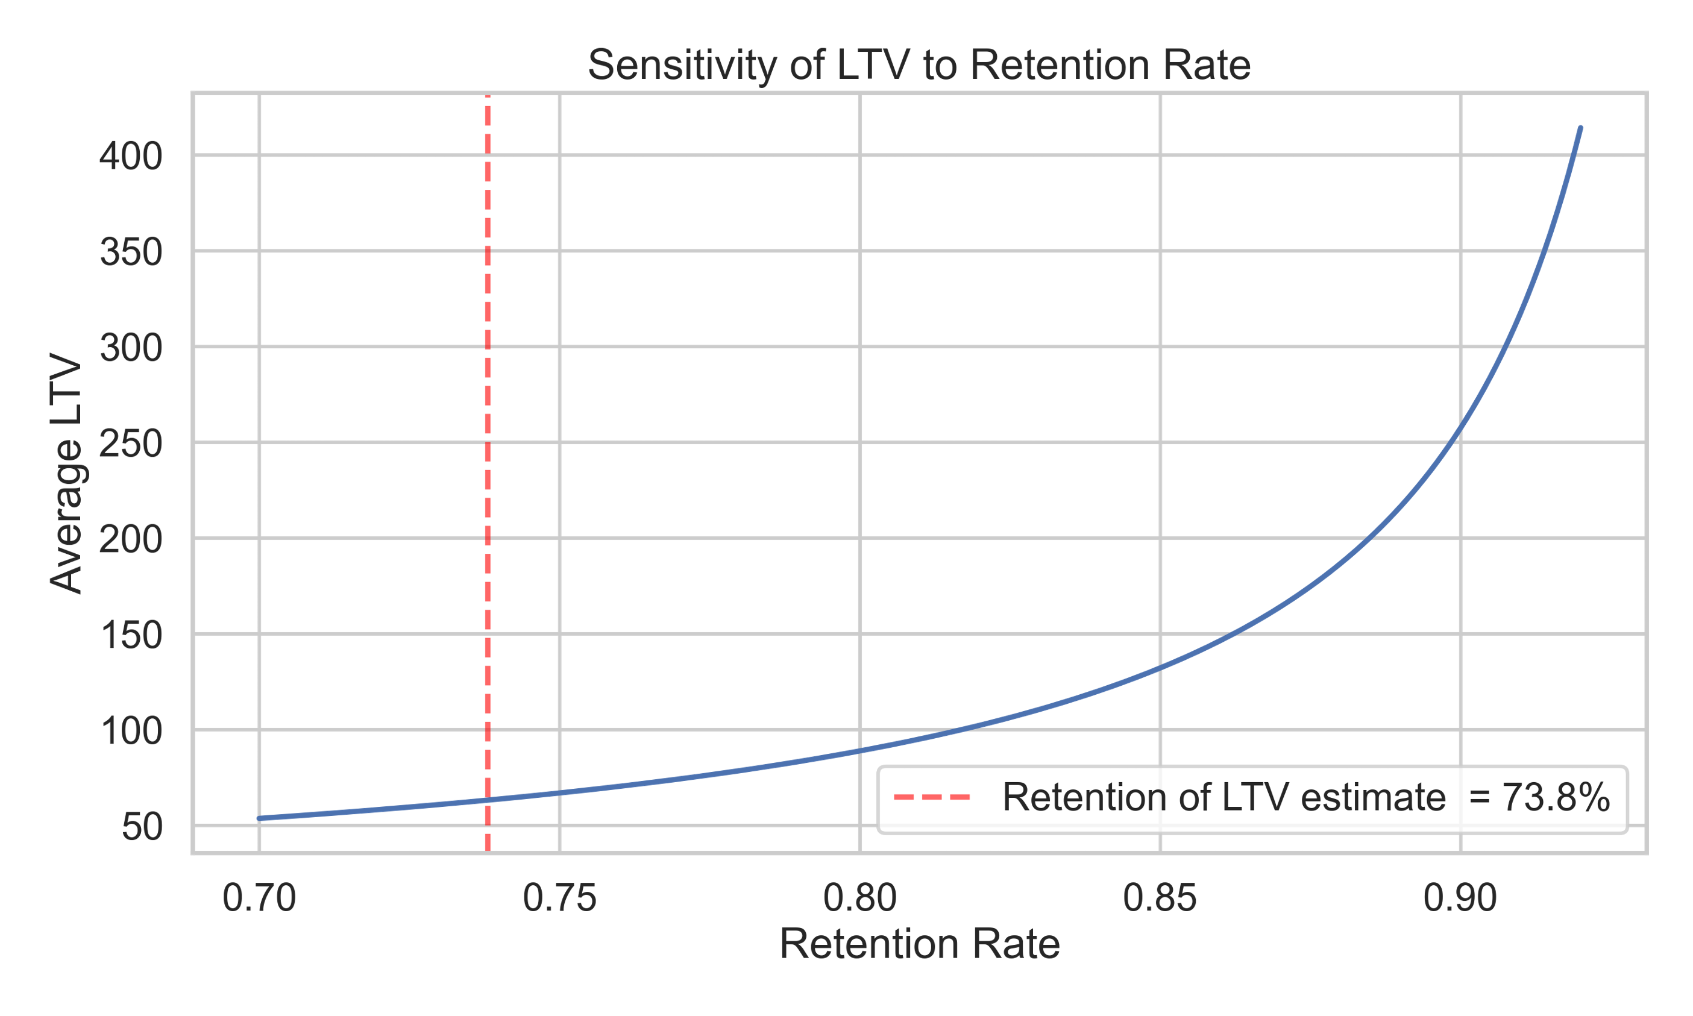
What's the Problem
What We Discovered
How We Approached It
How It Drives Strategy
Retention Is the Exponential Lever
Small improvements lead to exponential value gain
18

Slide 19
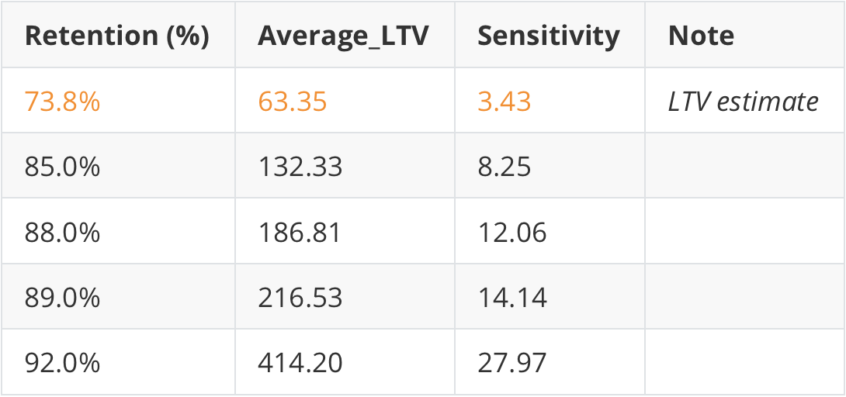
What's the Problem
What We Discovered
How We Approached It
How It Drives Strategy
Retention Is the Exponential Lever
💡 Sensitivity Coefficient tells us how much LTV changes for a 1% change in the parameter
Small improvements lead to exponential value gain
Why 73.8% retention appears 👉
lower than you might expect?
19

Slide 20
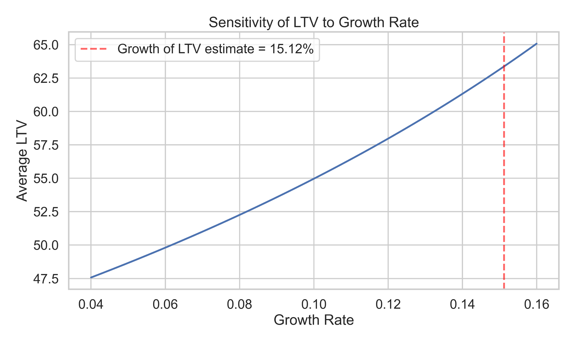
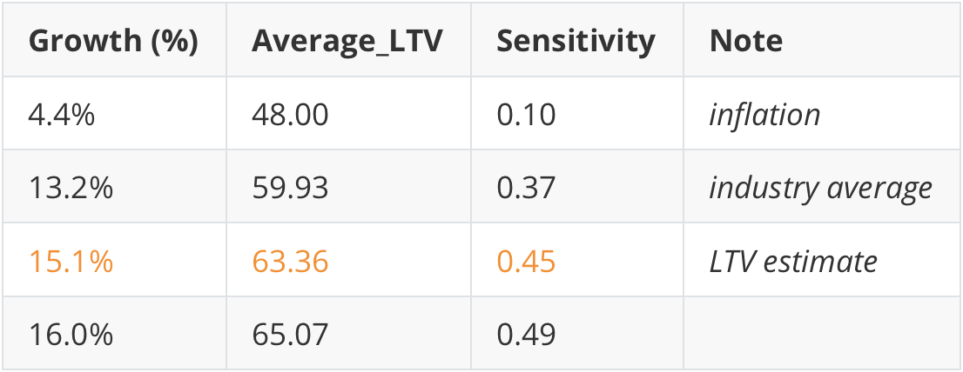
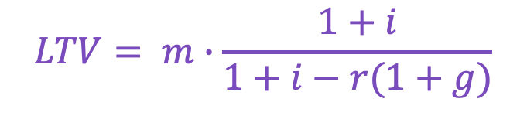
What's the Problem
What We Discovered
How We Approached It
How It Drives Strategy
How Growth Rate (g) Affects LTV
Small acceleration, moderate impact — and it only works if clients stay
$$LTV= m∙\frac{1+i}{1+i−r(1+g)}$$
20

Slide 21
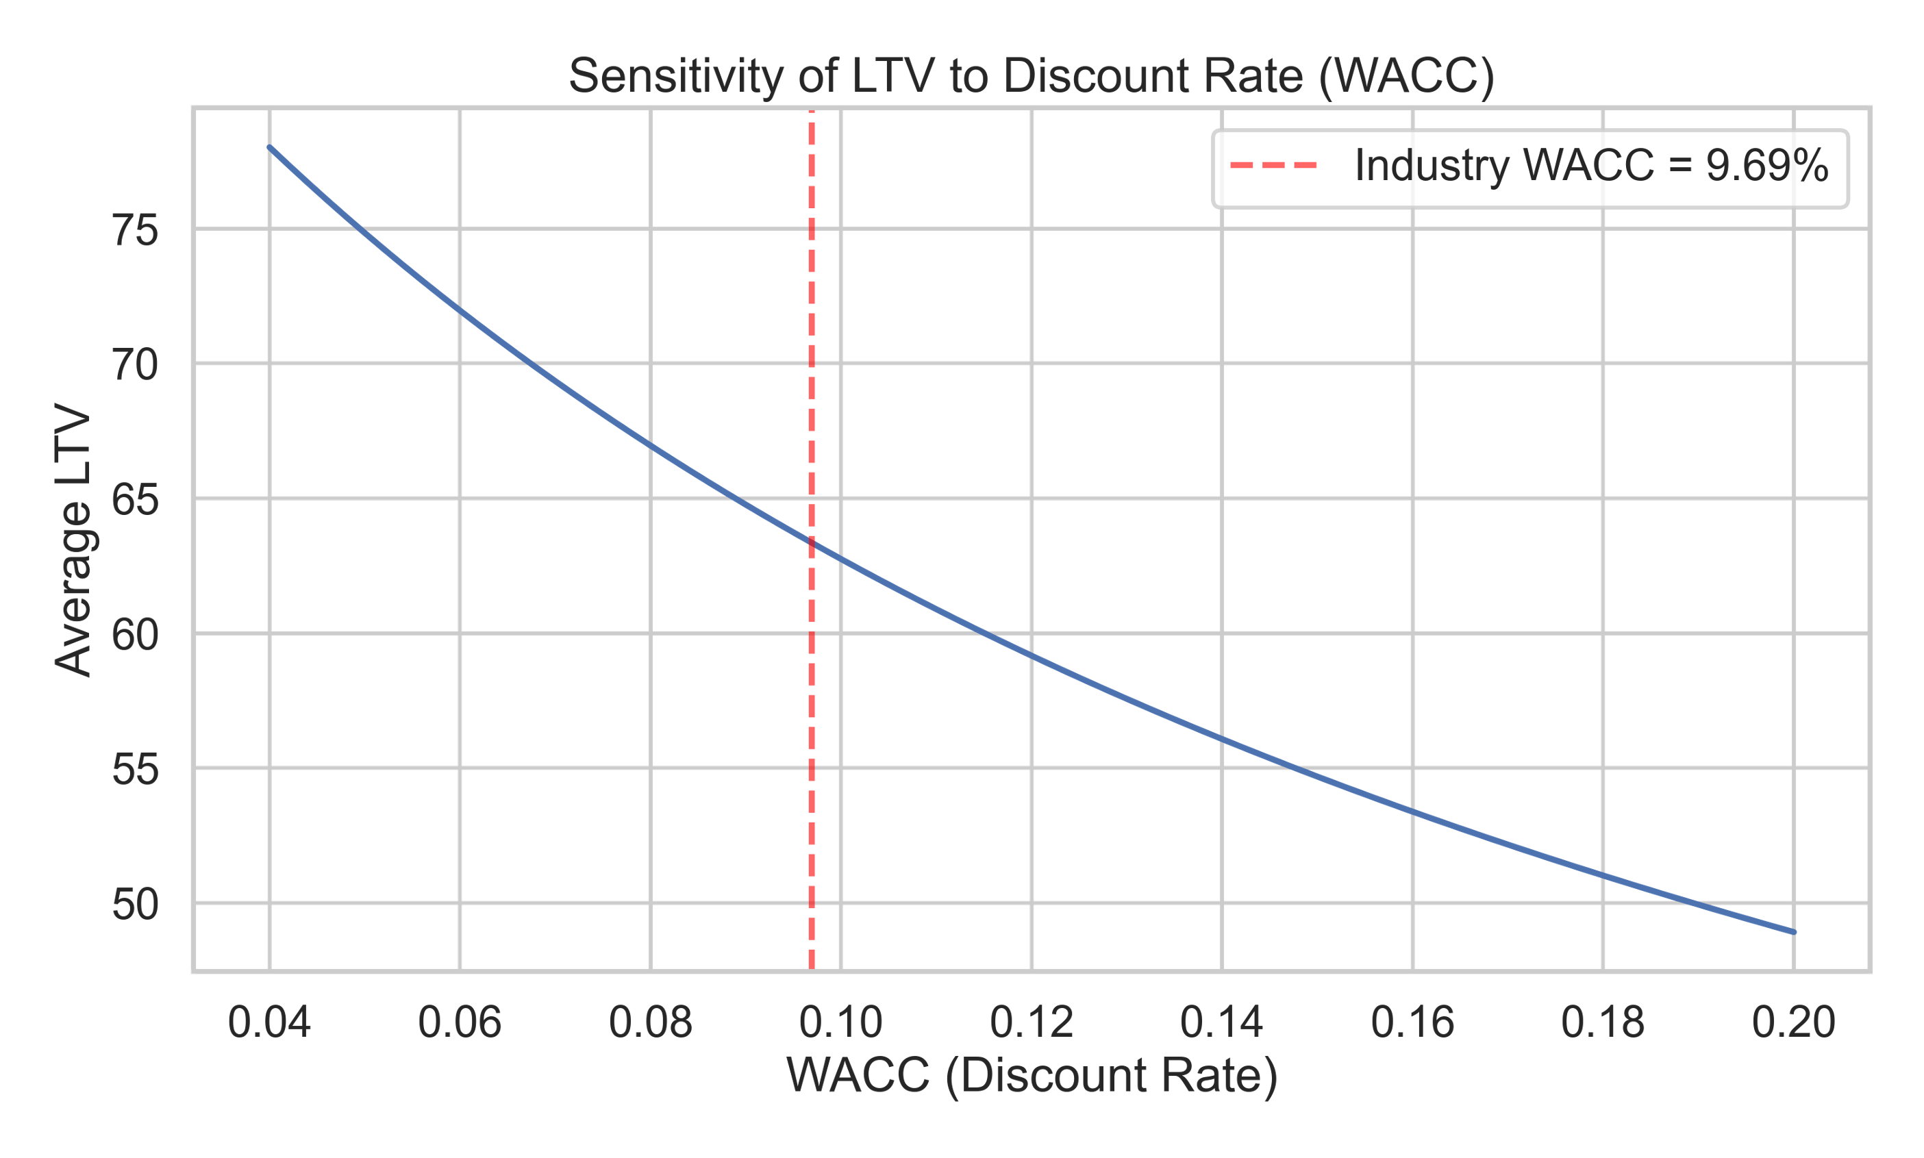
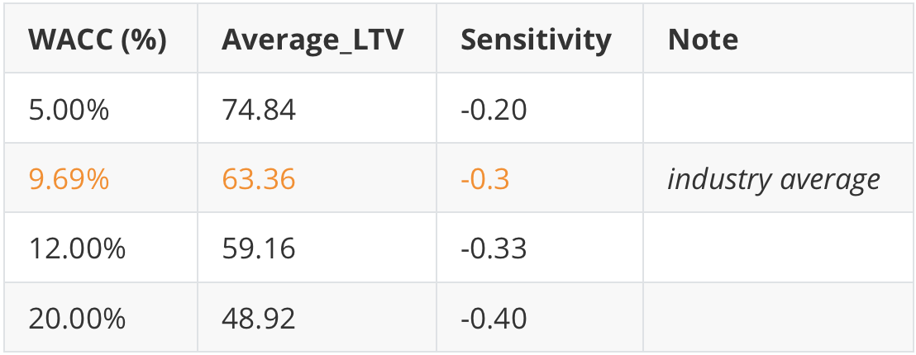
What's the Problem
What We Discovered
How We Approached It
How It Drives Strategy
How Financing Cost (Interest Rate, i) Affects LTV
An uncontrollable drag — but one we need to plan around
📖 Industry Avg WACC: from NYU Stern / Damodaran
$$LTV= m∙\frac{1+i}{1+i−r(1+g)}$$
21

Slide 22
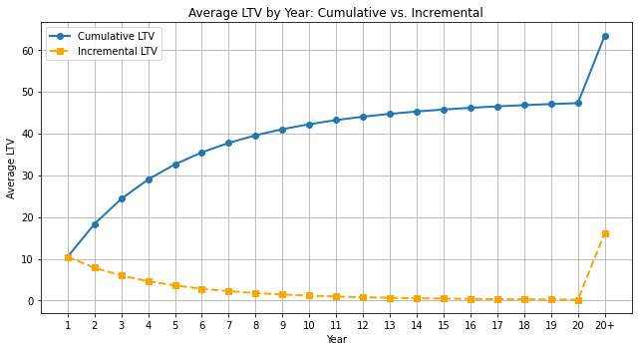
What's the Problem
What We Discovered
How We Approached It
How It Drives Strategy
Retention Builds the Base, Acquisition Extends the Frontier
Retention creates exponential value — but can't fuel growth forever
Retention delivers steep value gain in early years
By year 4, half of LTV has already materialized
After year 8, marginal value flattens
New clients are needed to maintain revenue momentum
Retention creates value. Acquisition sustains momentum. You need both!
💡 More than 60% of LTV
realized within the first 8 years
22

Slide 23
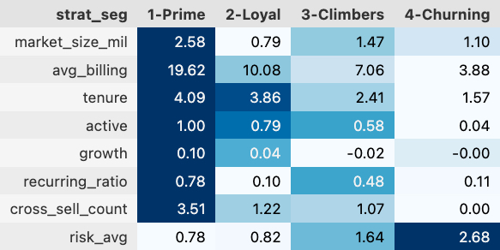
What's the Problem
What We Discovered
How We Approached It
How It Drives Strategy
Strategic Segments: A Portfolio View of Customer Value
Grouped for clarity — derived from 7 clusters, driven by behavior
We grouped clients into four strategic segments to simplify communication and enable business action.
These segments reflect differences in billing, engagement, risk, and growth potential.
This heatmap summarizes their key signals — you’ll see clear contrasts in billing, tenure, and risk.
⚠️ Note: This merge favors clarity. For actual execution, we recommend operating at the 7-cluster level to retain granularity.
The “Climbers” segment, for example, combines both high-growth and lower-engagement clusters — hence the dip in active rate
23

Slide 24
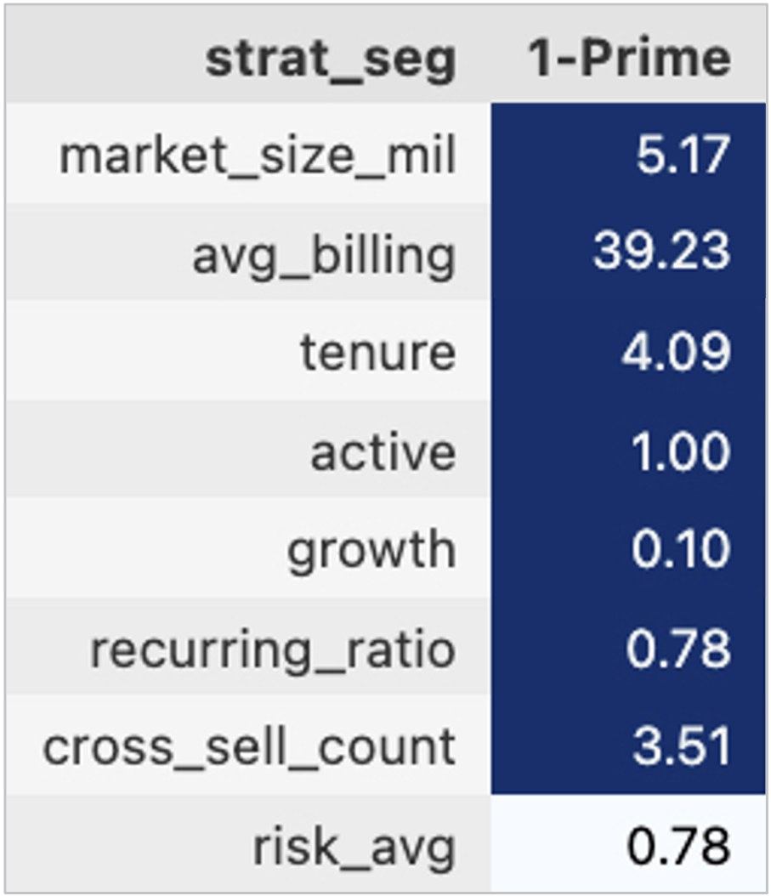
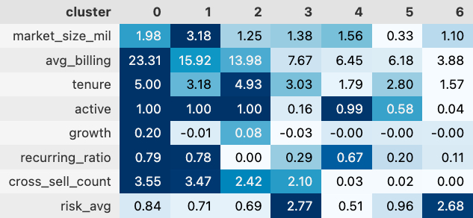
What's the Problem
What We Discovered
How We Approached It
How It Drives Strategy
Prime & Loyal: High Value, Low Risk — But Different Plays
Two retaining segments, two very different strategies
🔹 Prime (C0 + C1)
High billing, wide product usage, active & loyal
Top-tier LTV & engagement — ideal for flagship marketing
Strategic moves:
Deepen with cross-sell & success teams
Feature in referral & showcase programs
million ppl (staff)
units
years
%
%
%
#
x/4 score
⚠️ Note: This merge favors clarity. For actual execution, we recommend operating at the 7-cluster level to retain granularity.
24

Slide 25
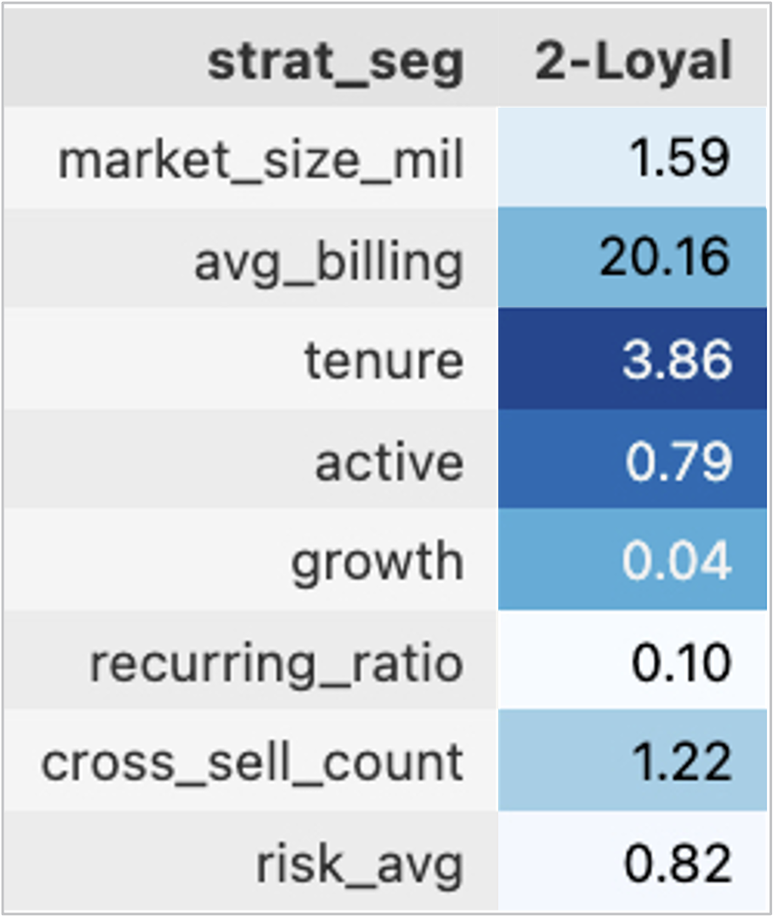
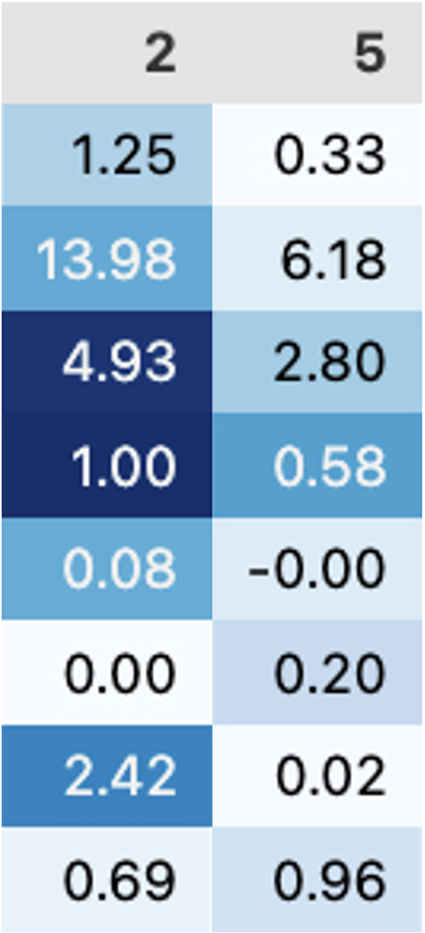
What's the Problem
What We Discovered
How We Approached It
How It Drives Strategy
Prime & Loyal: High Value, Low Risk — But Different Plays
Two retaining segments, two very different strategies
🔹 Loyal (C2 + C5)
Passive users, but low churn & stable tenure
Low-touch needed — but don't neglect renewals
Strategic moves:
Low-cost email/drip campaigns
Consider auto-renew or passive engagement programs
million ppl (staff)
units
years
%
%
%
#
x/4 score
⚠️ Note: This merge favors clarity. For actual execution, we recommend operating at the 7-cluster level to retain granularity.
25

Slide 26
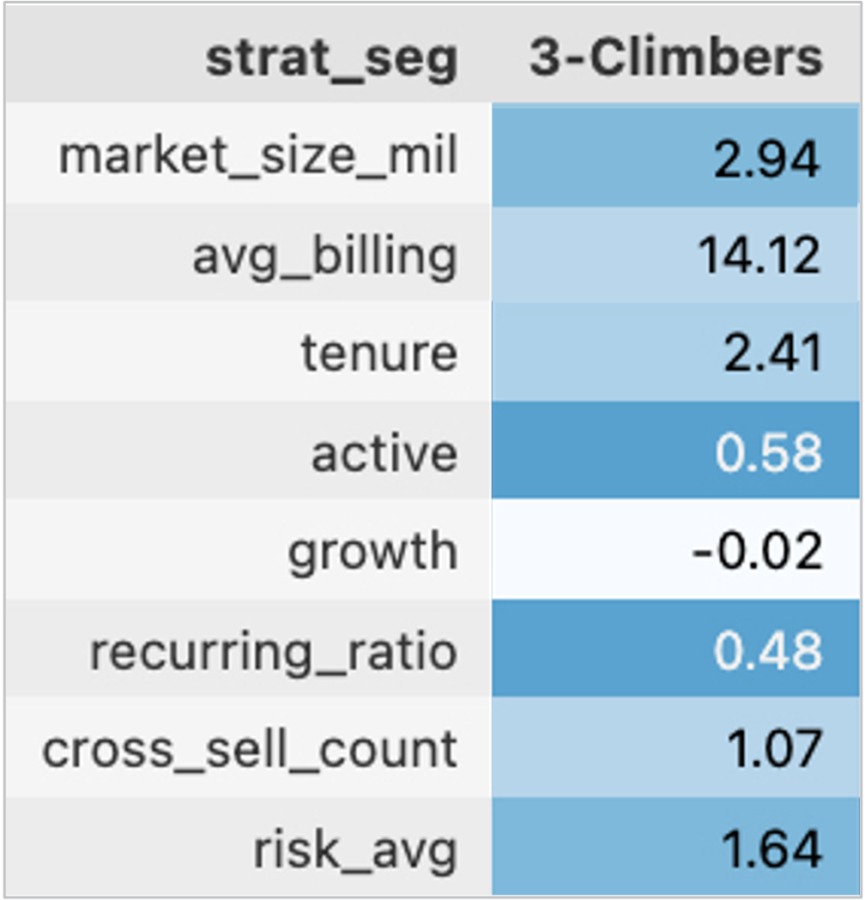
What's the Problem
What We Discovered
How We Approached It
How It Drives Strategy
Climbers & Churning: Nurture or Exit
Emerging upside — and the warning signs
🔹 Climbers (C3 + C4)
High growth signals — especially in C4
But engagement is mixed due to C3’s
shallow usage
Strategic moves:
Onboarding optimization, education nudges
Set risk watchlists, define reactivation triggers
Experiment with test campaigns or limited offers
million ppl (staff)
units
years
%
%
%
#
x/4 score
⚠️ Note: This merge favors clarity. For actual execution, we recommend operating at the 7-cluster level to retain granularity.
26

Slide 27
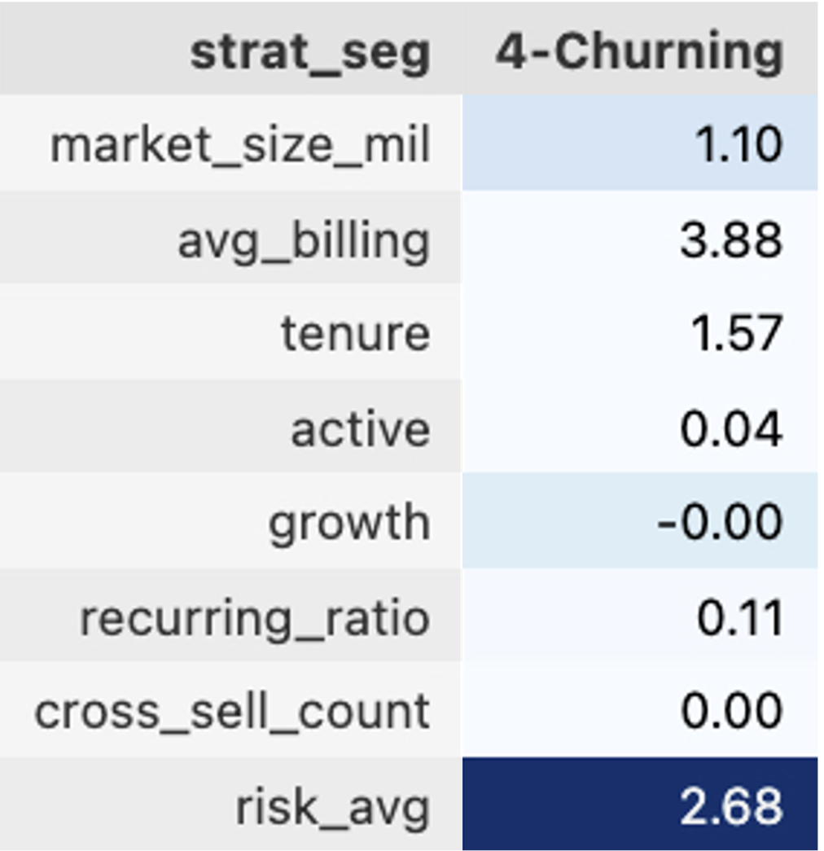
What's the Problem
What We Discovered
How We Approached It
How It Drives Strategy
Climbers & Churning: Nurture or Exit
Emerging upside — and the warning signs
🔹 Churning (C6)
Extremely low activity and poor retention
High churn scores, often post-onboarding drop-offs
Strategic moves:
Exit flow design — offboarding, feedback capture
Or experiment with last-touch recovery campaigns
Consider reducing CS effort / automating deactivation
million ppl (staff)
units
years
%
%
%
#
x/4 score
⚠️ Note: This merge favors clarity. For actual execution, we recommend operating at the 7-cluster level to retain granularity.
27

Slide 28
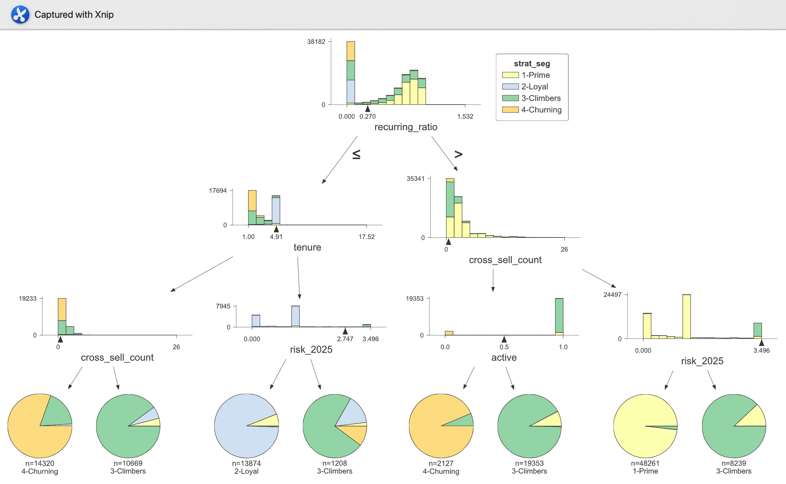
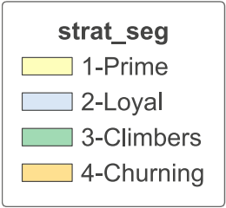

What's the Problem
What We Discovered
How We Approached It
How It Drives Strategy
Validation with Decision Tree
💡 Churning clients often have short tenure and low recurring usage.
🌱 Climbers show up as new clients who are highly active, but still some churn risk.
28

Slide 29
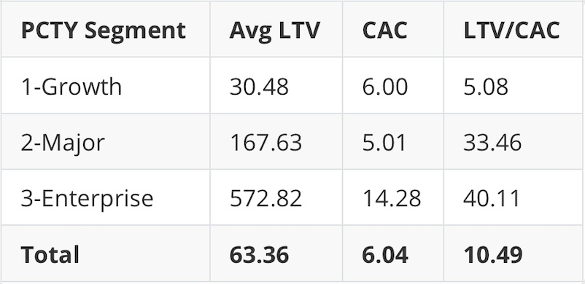
What's the Problem
What We Discovered
How We Approached It
How It Drives Strategy
ROI Snapshot: Where Do We Win?
LTV-to-CAC ratios tell us which segments drive profitable growth. (Based on Paylocity’s internal segmentation and CAC assumptions.)
CAC: Estimated, not modeled — provided by client as rough benchmarks
Enterprise ROI is exceptional (40x), but accounts for only 16% of billing
Growth segment has decent return (5x) — but potential may be capped
Takeaway: Helps prioritize investment across segments based on potential payoff
29

Slide 30
HOW IT DRIVES STRATEGY
30

Slide 31
What's the Problem
What We Discovered
How We Approached It
How It Drives Strategy
Turning Segment Insights into Strategy
Tailored actions by customer segment to maximize value
High-touch CS
Strategic partnership
Referrals
Maintenance flows
Occasional check-ins
Prime
💎
Loyal
🤝
LTV = 88.41
LTV = 53.61
Climbers
📈
Churning
🧨
LTV = 17.65
LTV = 11.07
Diagnostic flags
Low-cost retention
Offboarding flow
Onboarding + Nurture flows
Upsell triggers
31

Slide 32
What's the Problem
What We Discovered
How We Approached It
How It Drives Strategy
Scoring and Prioritization in Salesforce
LTV Model Output
Score + Segment Tag
Sync to Salesforce
Actions in CRM
Using LTV + Retention to guide budget and outreach in real-time
Why this matters
Your CRM (e.g., Salesforce) is where reps make day-to-day decisions
Embedding LTV + Segment scores = smarter resource allocation
Let sales/CS see: who to focus on, who’s at risk, who to grow
What we recommend
Integrate LTV scores and segment labels into Salesforce client records
Create workflows that:
Flag high-potential climbers for onboarding push
Set CS priorities by segment (e.g., Prime = high touch)
Trigger retention playbooks for Churning clients
Outreach prompts
Budget decisions
Lifecycle playbooks
32

Slide 33
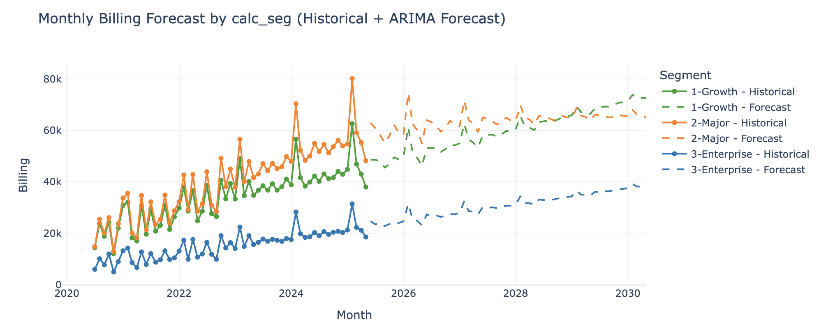
What's the Problem
What We Discovered
How We Approached It
How It Drives Strategy
Bridging Potential and Reality
Comparing long-term LTV potential with SARIMA revenue forecasts
33

Slide 34
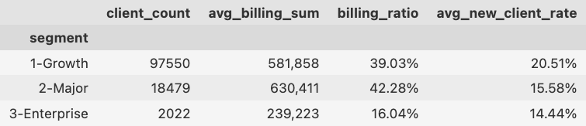
What's the Problem
What We Discovered
How We Approached It
How It Drives Strategy
Bridging Potential and Reality
💡 New client acquisition —
naturally beyond LTV’s scope
Comparing long-term LTV potential with SARIMA revenue forecasts
34

Slide 35
QUICK WRAP-UP
35

Slide 36
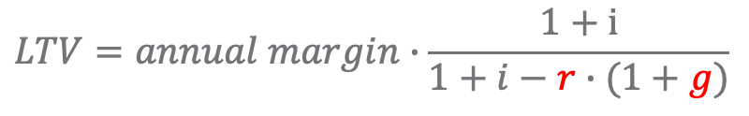
Quick Wrap-Up
Final Takeaways — Turning Insights into Action
Retention protects. Growth extends. Acquisition expands.
$$LTV=annual margin∙\frac{1+i}{1+i−r∙(1+g)}$$
💎 Retention protects the core — most value is realized early
Strengthen loyalty (Prime & Loyal) and reduce churn through segment-based playbooks
📈 Growth matters — once retention is strong
Expand future stars (Climbers) with upsell nudges and onboarding reinforcement
🌍 Acquisition expands the frontier — it’s how scale happens
Target strategically with real-time clustering, not just demographic profiles
36

Slide 37
Thank You!
UW x PCTY Capstone Project
37

Slide 38
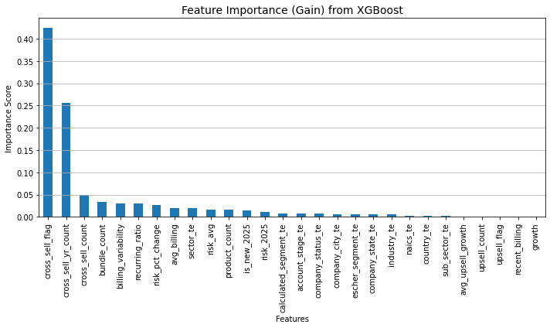
Appendix 1.1
Modeling Retention – Feature Importance (XGBoost)
Top drivers of customer lifespan prediction, ranked by model contribution
38

Slide 39
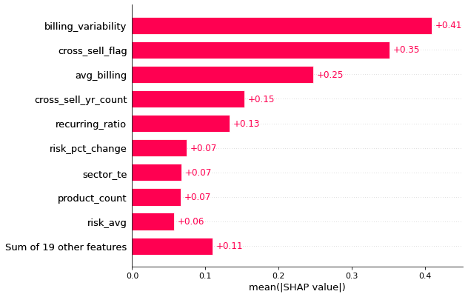
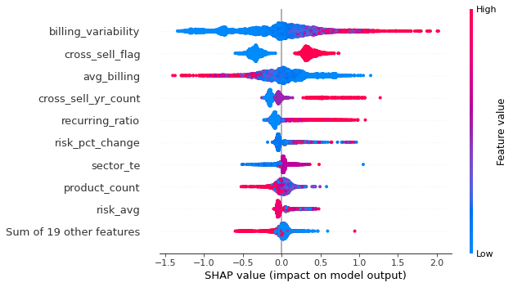
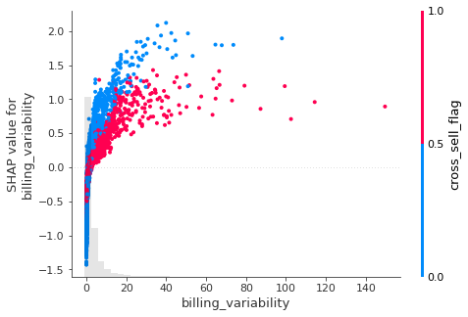
Appendix 1.2
Modeling Retention – SHAP Analysis
Explaining the model: how each feature pushes retention predictions up or down
39

Slide 40
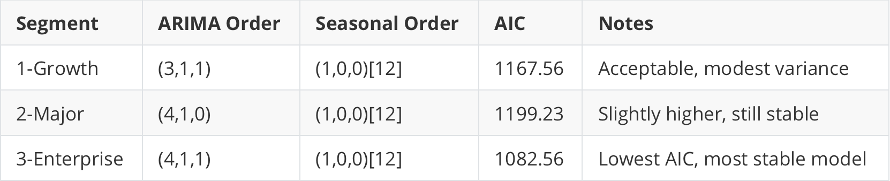
Appendix 2.1
SARIMA Model Selection Summary by Segment
Auto-selected via AIC optimization using 60 months of segment-level billing data
We selected the SARIMA configuration for each segment based on the lowest AIC value found via auto_arima.
All models have moderate complexity and include yearly seasonality.
AIC values range from 1082 to 1199, indicating reasonable fit given the data scale (~60 monthly observations).
40

Slide 41
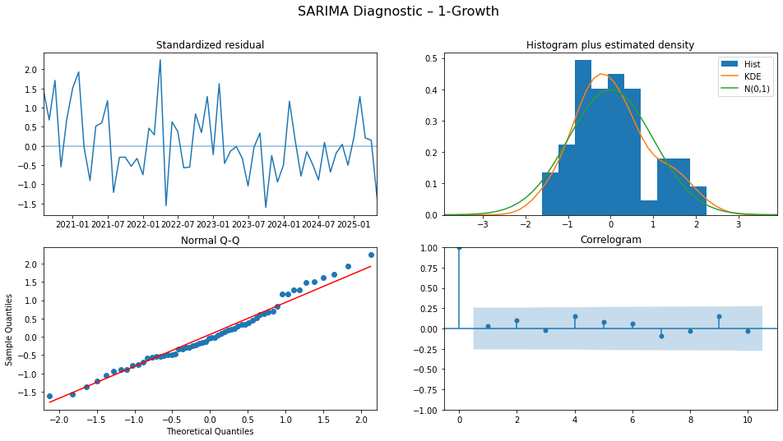
Appendix 2.2
SARIMA Residual Diagnostics
Residuals across all segments behave as white noise — no signal left unexplained.
41
Notes:
• Residuals approximate a normal distribution
• No significant autocorrelation remains
• Standardized errors show no drift over time

